Slide 1
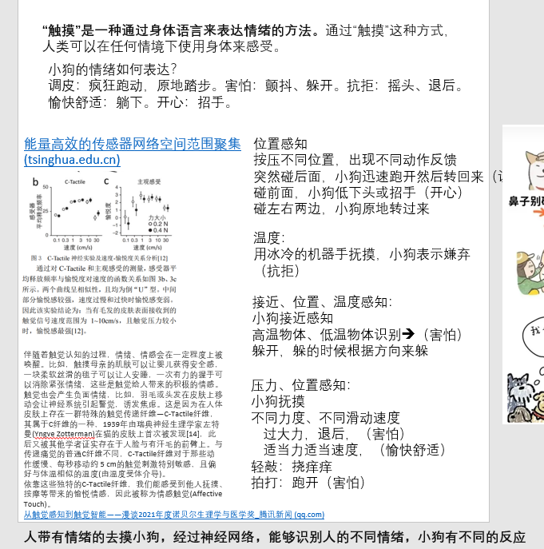
1、拍中间：小狗招手 khi
2、拍后面：小狗跑开转一圈回来 wkF+vtL+wkF
3、拍两边：原地转圈 vtL vtR (cmhL cmhR)
4、高温低温物体识别：小狗躲开（左右高度不同，大幅度倾斜）
5、挠痒：小狗蹲下摇晃 krl
6、抚摸：开心 krest
7、重拍：小狗害怕颤抖
8、碰前面：ksnf
睡觉 伸懒腰：krest+krc
动作类型
主人情绪
小狗反馈

Slide 2
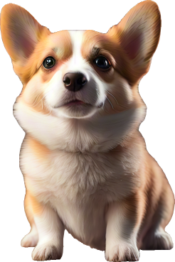

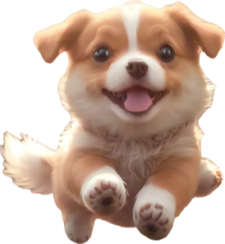







Slide 3



Slide 4
Emotion recognition
Emotion recognition
Emotion recognition
Emotion recognition
Emotion recognition
Emotion recognition
Emotion recognition
Emotion recognition
Emotion recognition
Emotion recognition
Emotion recognition
Emotion recognition
Emotion recognition
Emotion recognition
Emotion recognition
Emotion recognition
Emotion recognition
Emotion recognition

Slide 5
1、小狗睡觉，吵醒小狗，和小狗玩 用不同动作和小狗交互（无聊--开心）（加上温度ang）
挠痒（kscrh)
2、推开小狗，小狗跑过来拆家（dig、jmp) 摇头求关注（倒立hds、kgdb)（主人不耐烦）
3、重拍小狗，小狗害怕，逃走（生气）
4、摸小狗头，睡觉（惭愧）
动作类型
主人情绪
小狗反馈

Slide 6
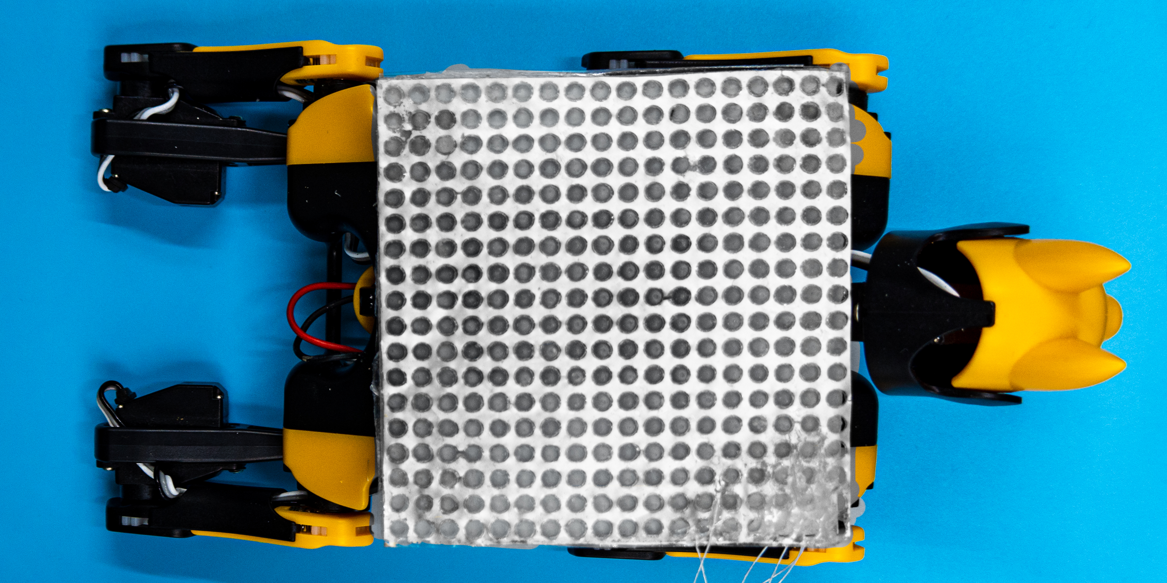

Slide 9
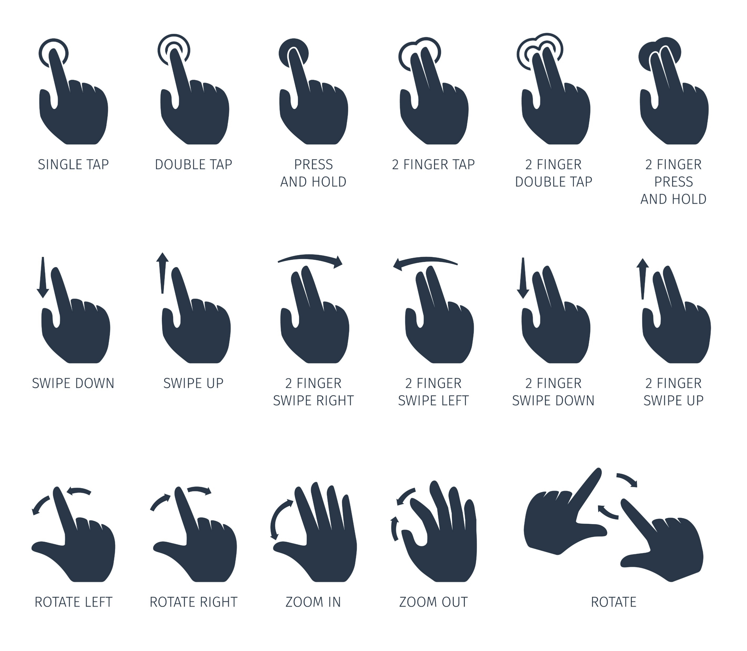







Slide 10



Slide 11
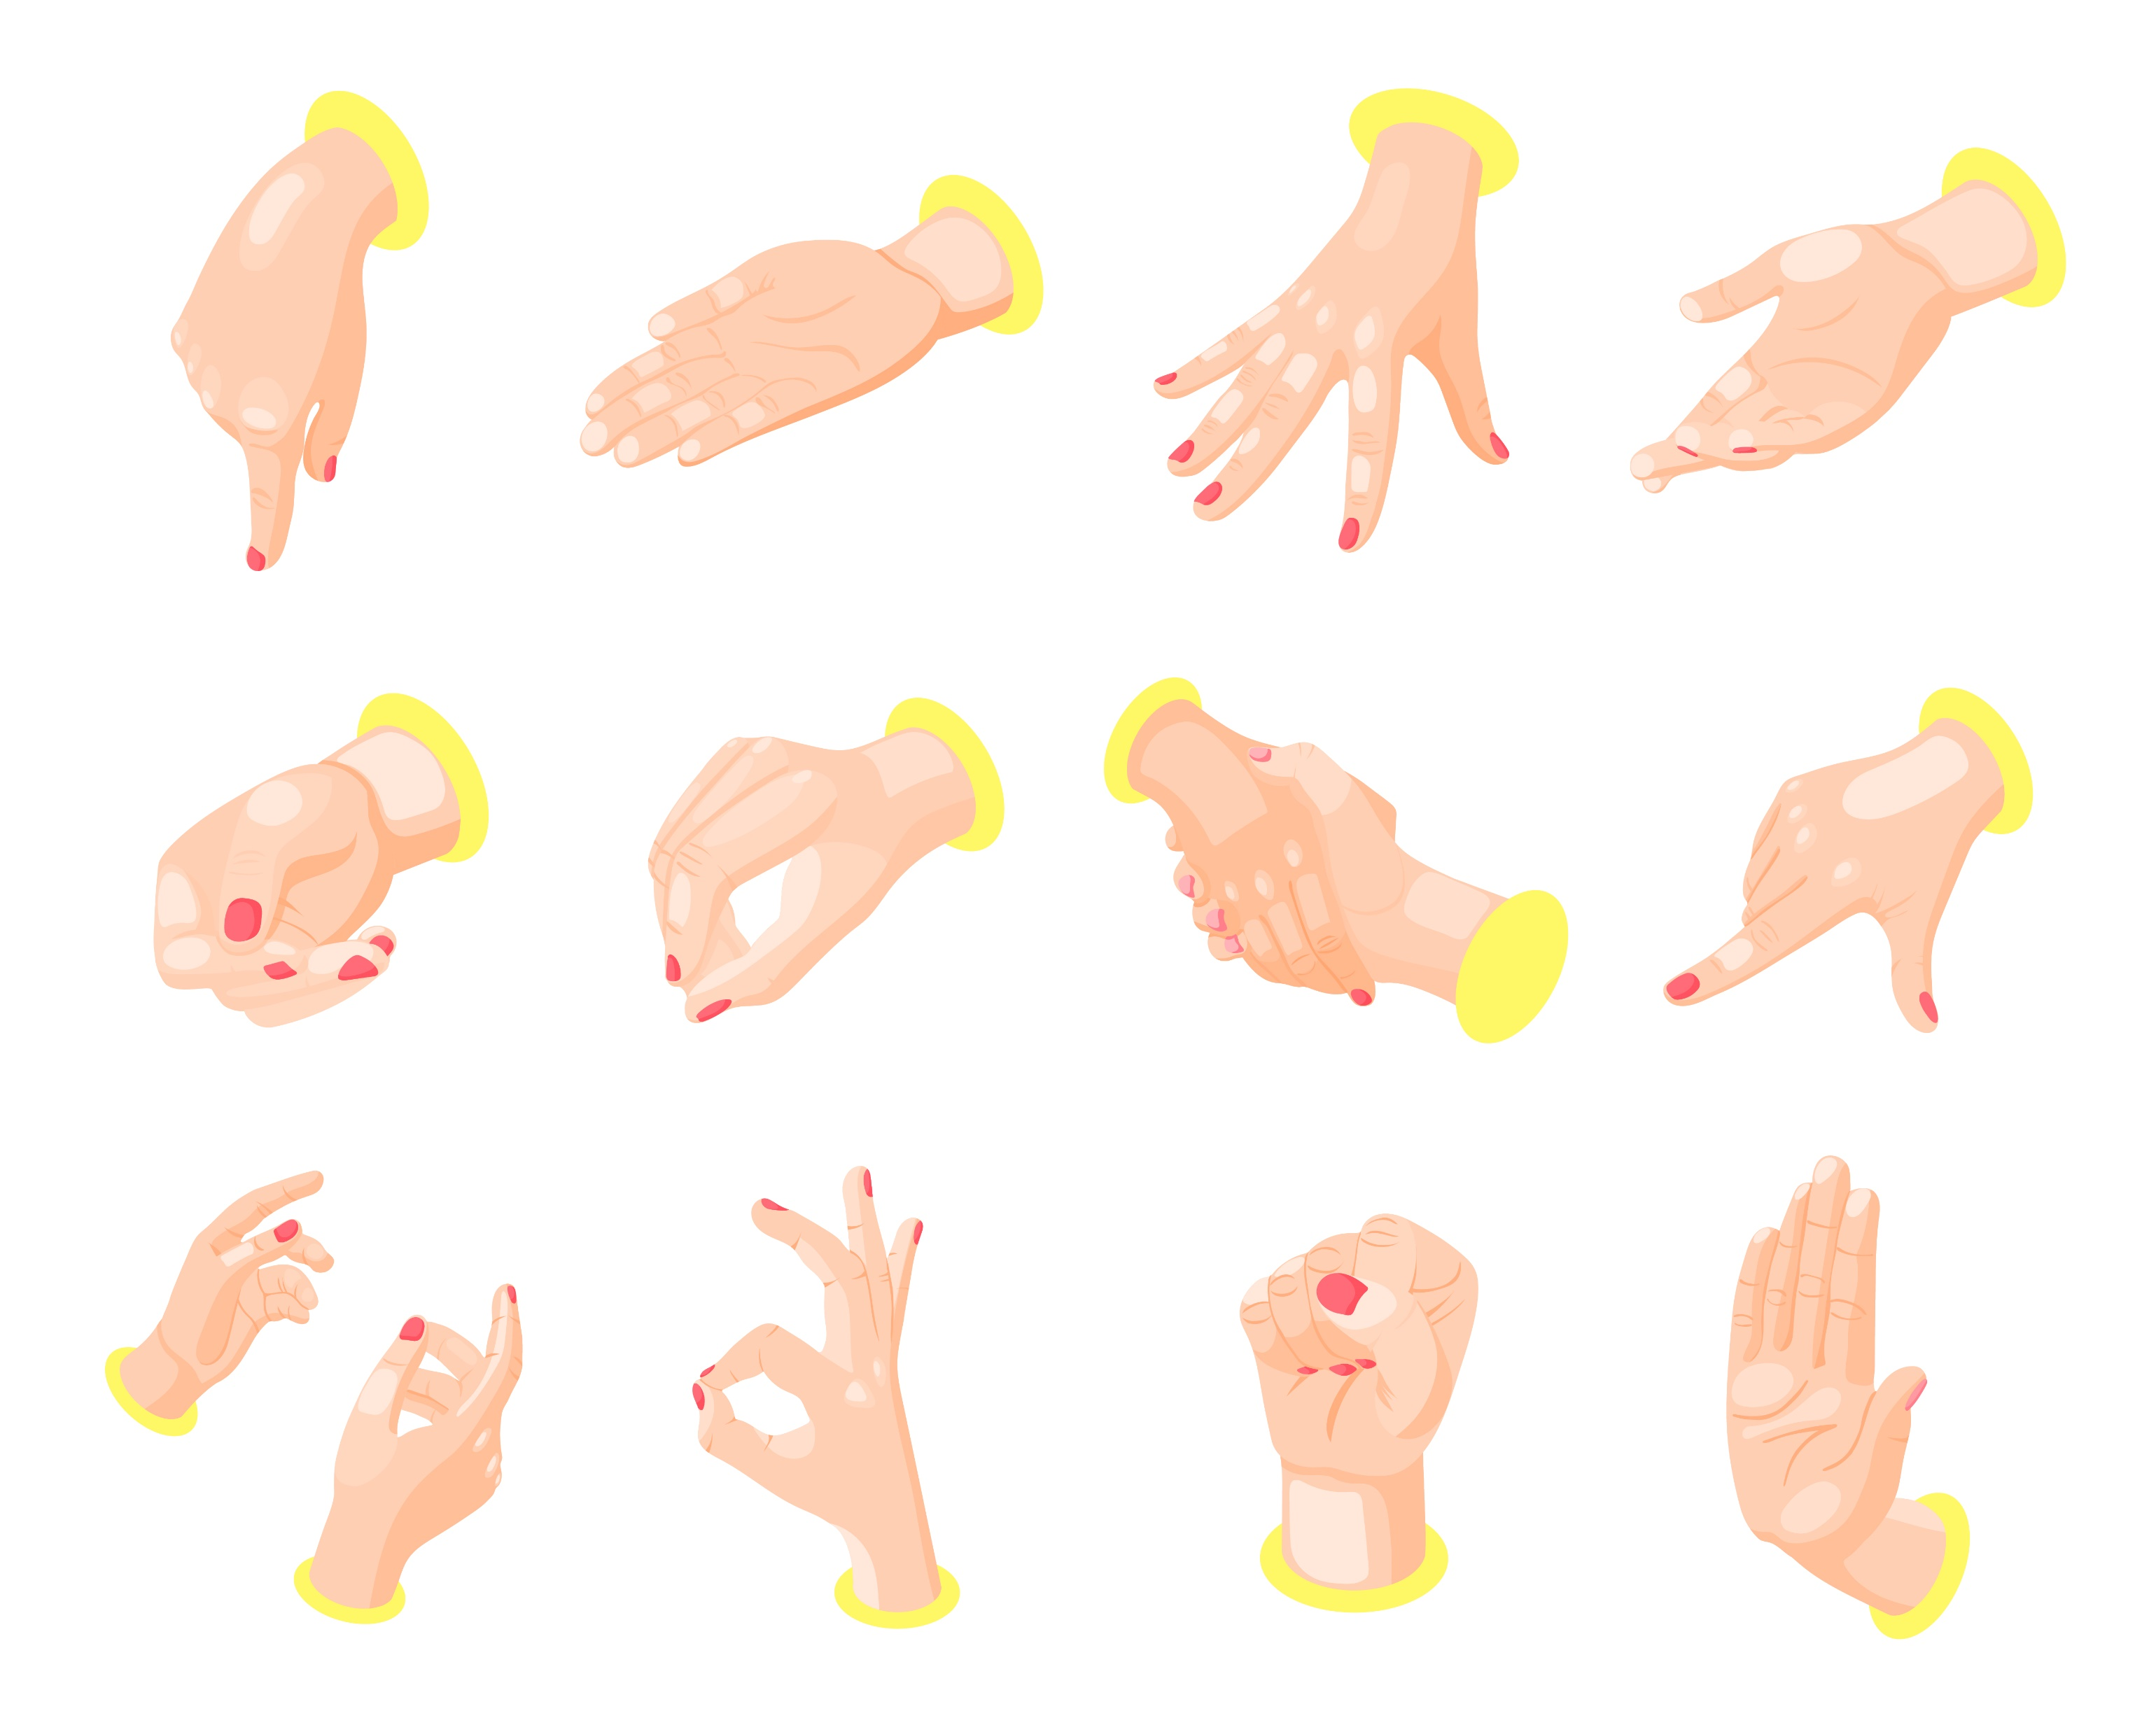


Slide 12
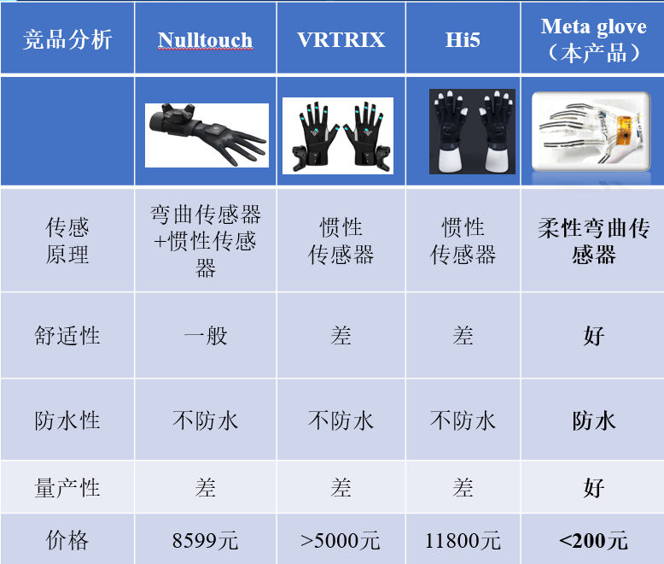
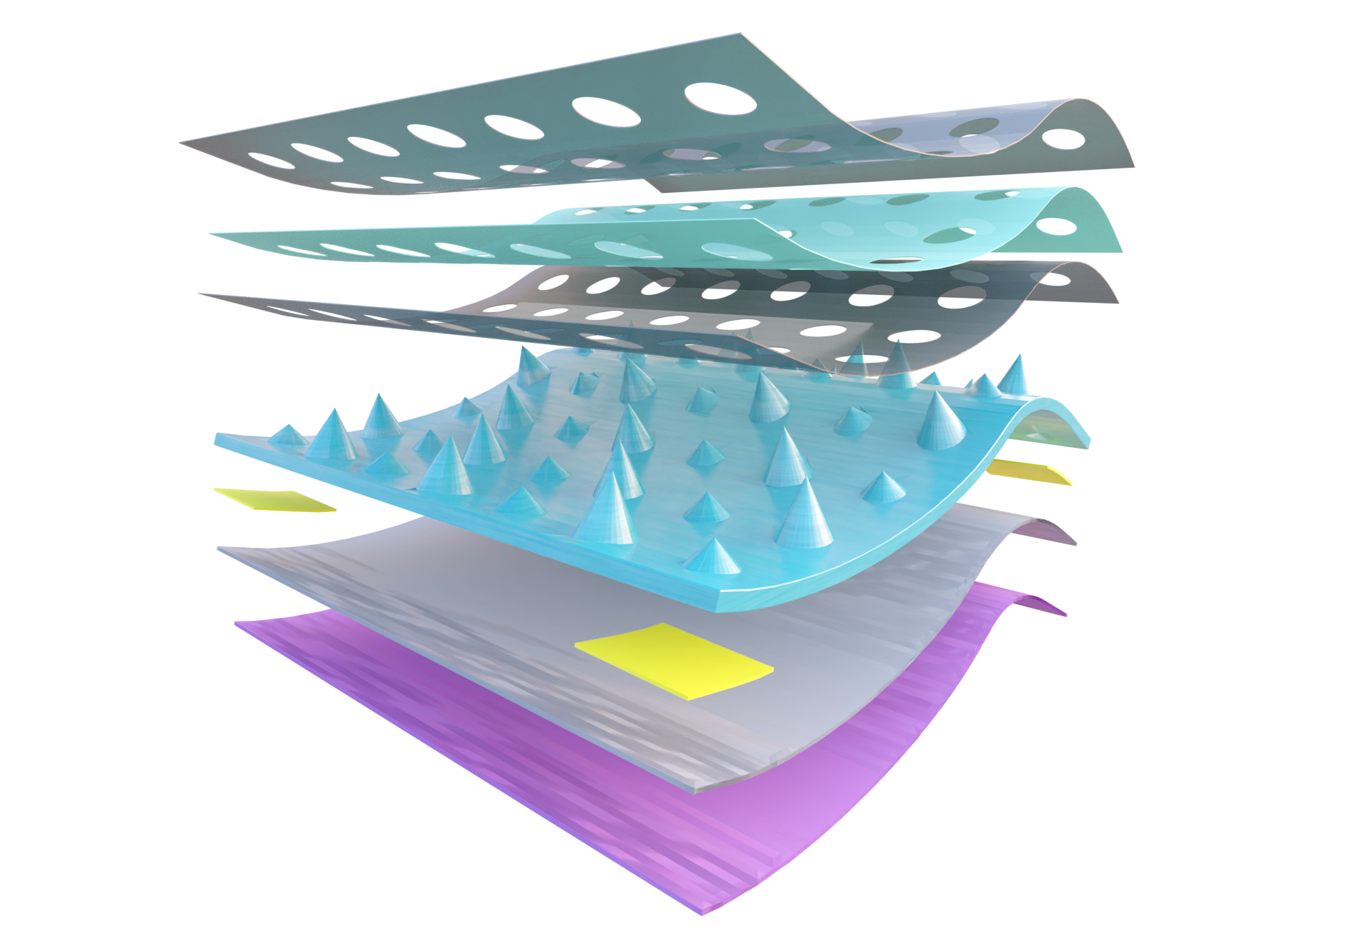
竞品分析 |  |  |  | 本产品
传感原理
传感精度 |  |  |  | 高
价格 |  |  |  | ＜200

Slide 13




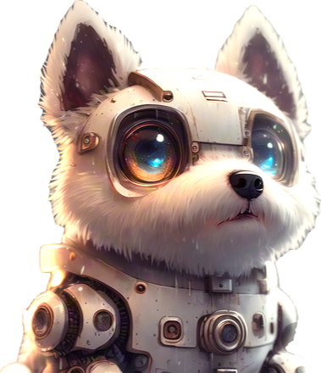

Slide 14
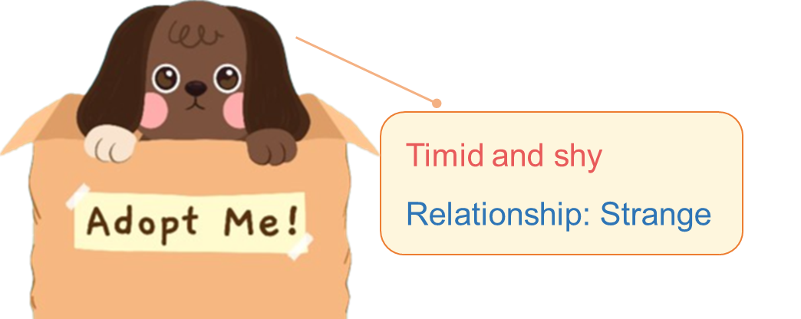
Timid and shy
Outgoing and lively
Relationship: Strange
Relationship: Intimate
Thinking . . .

Slide 15






Character:
Patient and caring
State:
Energetic
Character: Clingy
State:
Reluctant
Character:
Patient and caring
State:
Tired and despondent
Character:
Clingy
State:
Excited

Slide 16
Character: Patient and caring
Character: Patient and caring
State: Tired
State: Energetic
Character: Clingy
Character: Clingy

Slide 17



